Slide 1
An Investigation into How Best to Represent a 3D Cross Section of 4 Dimensional Objects
Joe Subbiani

Slide 2
Presentation Structure
What is the 4th Dimension
How to view the 4th Dimension
Building 4D Shapes
4D Rotation
Extensions to a 3D cross section
The Experiment
The Results

Slide 3
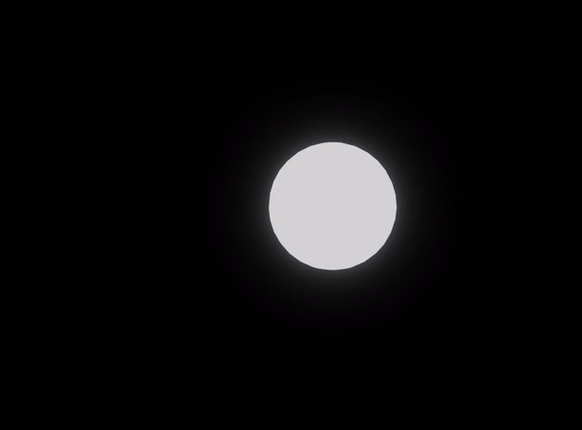
What is the 4th Dimension Structure

Slide 4
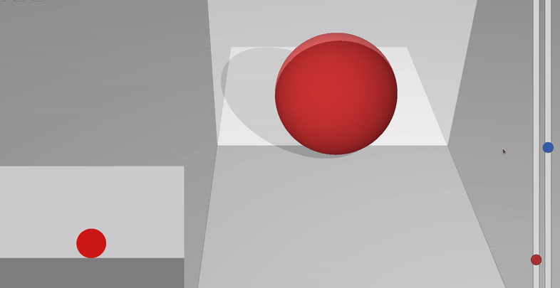
Taking A 3D Cross Section
How to view the 4th Dimension

Slide 5
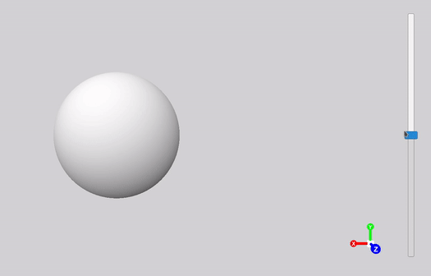
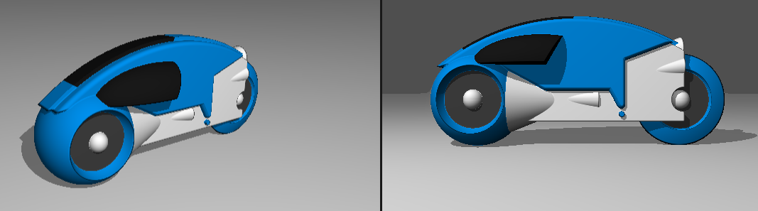
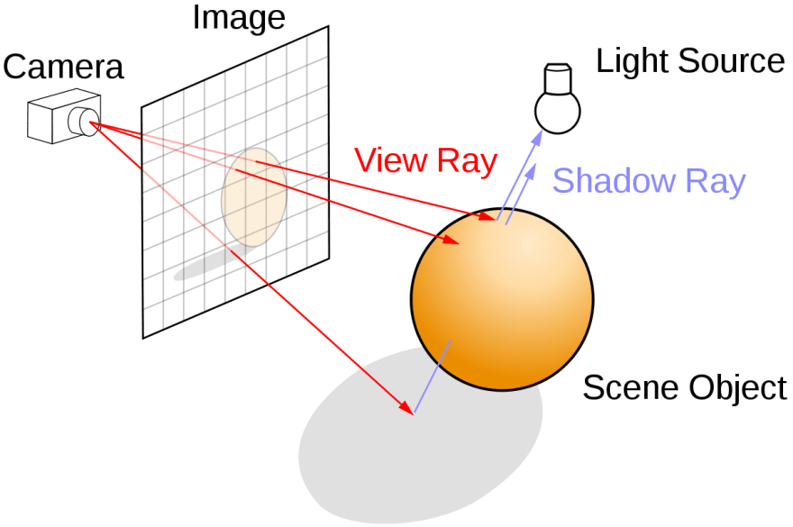
Ray Marching
Building 4D Shapes
Ray Marched 3D cross section of a 4D hypersphere
Personal Ray Marching Experiment in Unity
Fun Fact: The original Tron used Ray Marching!
Raymarching Diagram Credit

Slide 6
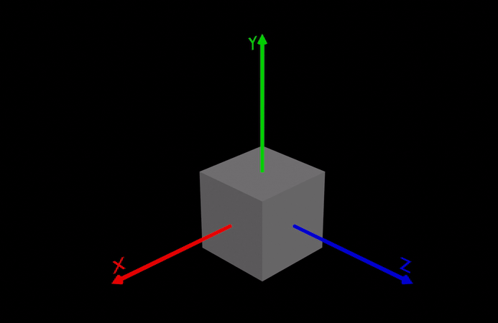
Rotating About a Plane
4D Rotation

Slide 7
The Rotor
4D Rotation

Slide 8
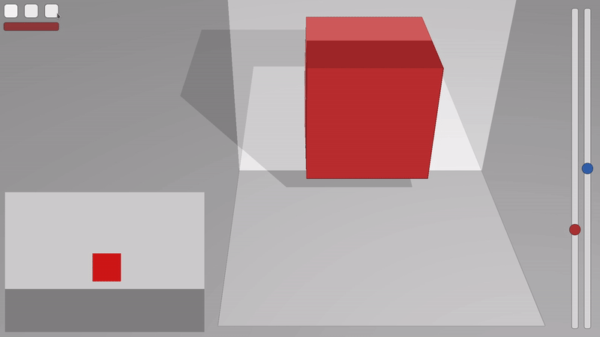
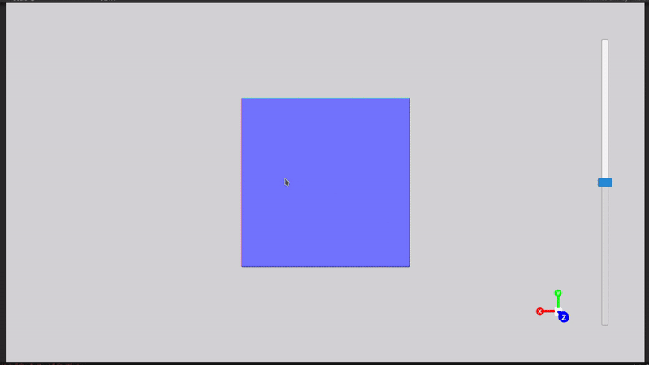

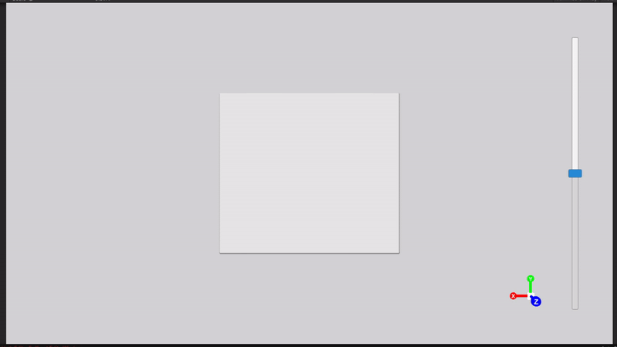
4D Rotation - 2D 3D 4D
2D Cross Section of 3D Object
3D Cross Section of 4D Object
Rotation within dimensions
Rotation outside of dimensions

Slide 9
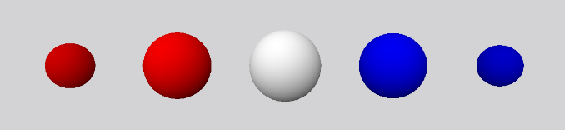
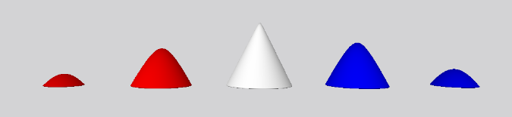
W-Axis “Timeline”
Extending a Cross Section of a 4D Object

Slide 10
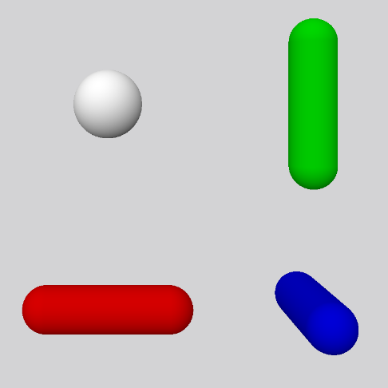
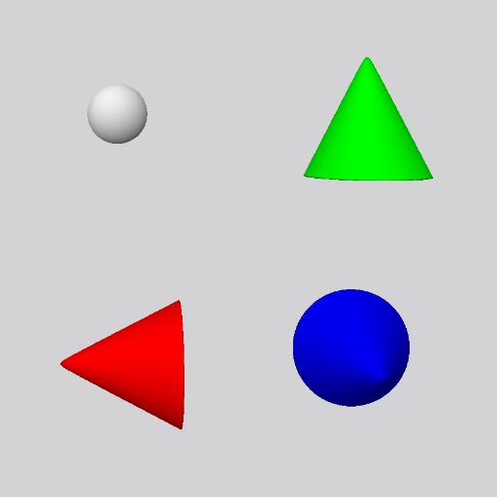
Multi-Rotational Views
Extending a Cross Section of a 4D Object
All 2D 90⁰ cross sections of a 3D Cylinder

Slide 11
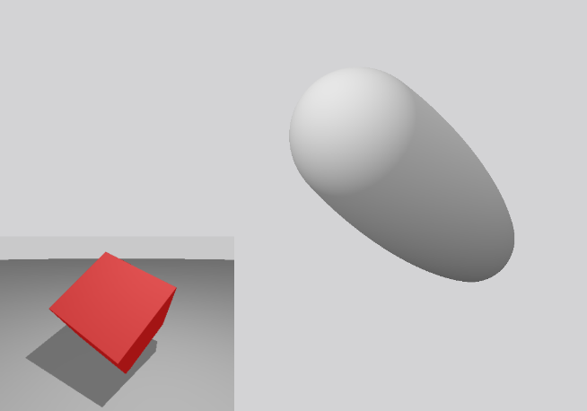
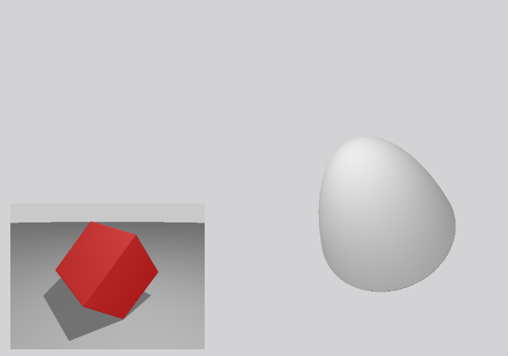
3D Axial Rotations on the 3D Component of a 4D Plane of Rotation
Extending a Cross Section of a 4D Object

Slide 12
The Experiment

Slide 13
The Results

